Slide 1
Cs1231 T12 tutorial #7
Functions
based on slides by Sanjay Saha and Aaron Tan

Slide 2
Learning objectives of this tutorial
Functions
ranges of functions
equality of functions
composition of functions
surjectivity, injectivity and bijectivity
inverse functions
setwise images and setwise preimages

Slide 3














Quick check: Which of the following are functions and which are not?
$$A$$
$$f_{1}$$
$$B$$
$$A$$
$$f_{2}$$
$$B$$
Informally, for a function, every element in the domain must have exactly one arrow coming out of it.
Note that nothing is said about elements in the codomain.
$$A$$
$$f_{3}$$
$$B$$
$$A$$
$$f_{4}$$
$$B$$

Slide 4


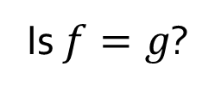


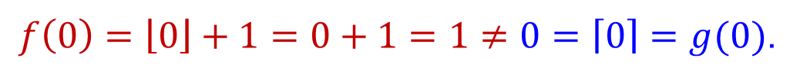


Q1.
Definition. The range or the image of a function $f:A→B$ is a defined to be
$$\left\{f\left(x\right) :x∈A\right\}.$$
Definition. For each $x∈ℚ$, define $\left\lfloor x\right\rfloor$ to be the largest integer $n$ such that $n⩽x$. Dually, for each $x∈ℚ$, define $\left\lceil x\right\rceil$ to be the smallest integer $n$ such that $n⩾x$.
Let $f,g:ℚ→ℚ$ defined by setting, for each $x∈ℚ,$
$$f\left(x\right)=\left\lfloor x\right\rfloor +1 and g\left(x\right)=\left\lceil x\right\rceil .$$
What is the range of $f$?
$$ℤ$$
Observation:
range $⊆$ codomain.
What is the range of $g$?
$$ℤ$$
Is $f=g$?
No.
Why?
$f\left(0\right)=\left\lfloor 0\right\rfloor +1=0+1=1≠0=\left\lceil 0\right\rceil =g(0)$.
Definition 9.1.6. Two functions $f:A→B$ and $g:C→D$ are equal (that is, $f=g$) if (1) $A=C$ and $B=D$; and (2) $f(x)=g(x)$ for all $x∈A$..

Slide 5
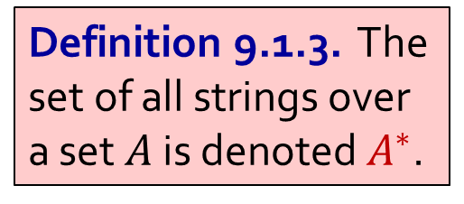
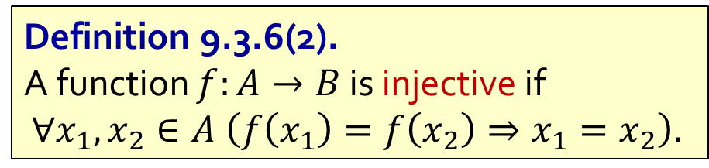

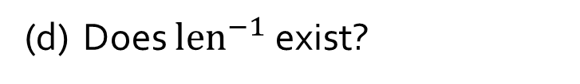

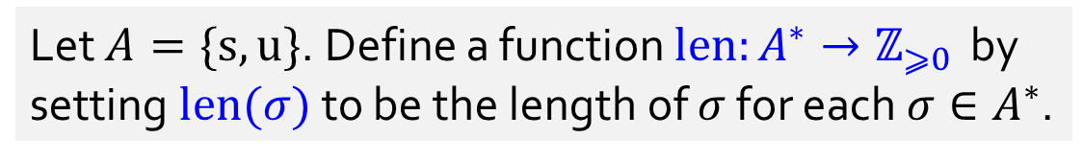

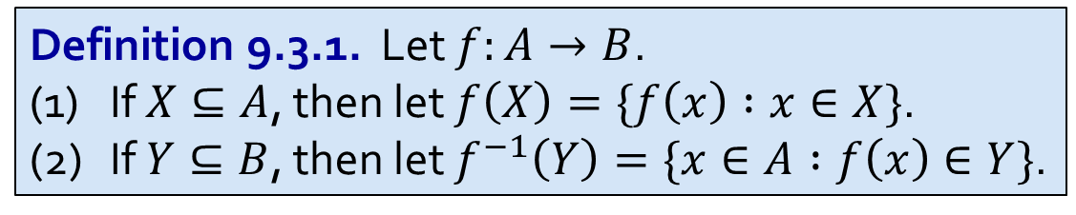
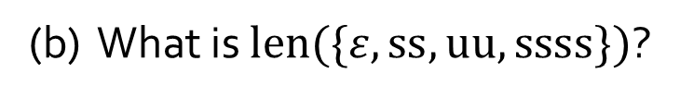


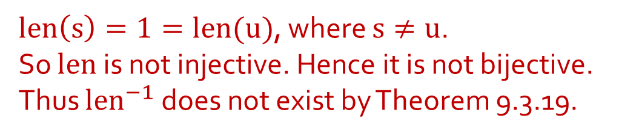
Q2.
Let $A=\{s,u\}$. Define a function $len:A^{∗}→ℤ_{⩾0 }$ by setting $len(σ)$ to be the length of $σ$ for each $σ∈A^{∗}$.
Definition 9.1.3. The set of all strings over a set $A$ is denoted $A^{∗}$.
(a) What is $len(suu)$?
$$3$$
(b) What is $len(\{ε,ss,uu,ssss\})$?
$$\{0,2,4\}$$
(c) What is ${len}^{−1}(\{3\})$?
$$\{sss,ssu,sus, uss,suu,usu,uus,uuu\}$$
(d) Does ${len}^{−1}$ exist?
No.
Explain your answer.
Definition 9.3.6(2).
A function $f:A→B$ is injective if
$∀x_{1},x_{2}∈A \left(f\left(x_{1}\right)=f\left(x_{2}\right)⇒x_{1}=x_{2}\right).$
$len\left(s\right)=1=len(u)$, where $s≠u$.
So $len$ is not injective. Hence it is not bijective.
Thus $len^{−1}$ does not exist by Theorem 9.3.19.
Definition 9.3.1. Let $f:A→B$.
(1) If $X⊆A$, then let $f\left(X\right)=\{f\left(x\right) :x∈X\}$.
(2) If $Y⊆B$, then let $f^{−1}\left(Y\right)=\{x∈A :f\left(x\right)∈Y\}$.
Theorem 9.3.19. A function is bijective iff it has an inverse.

Slide 6
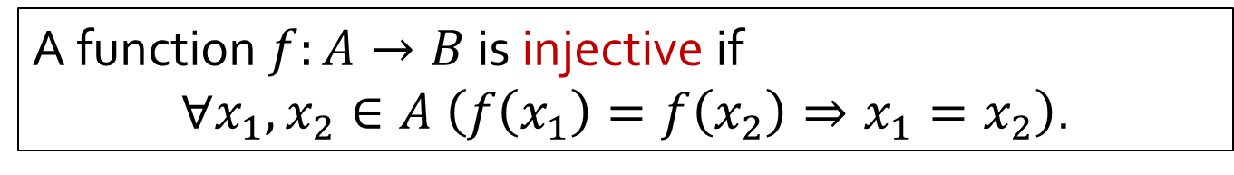
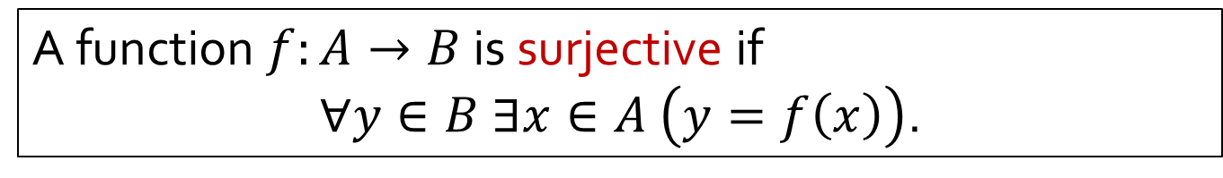


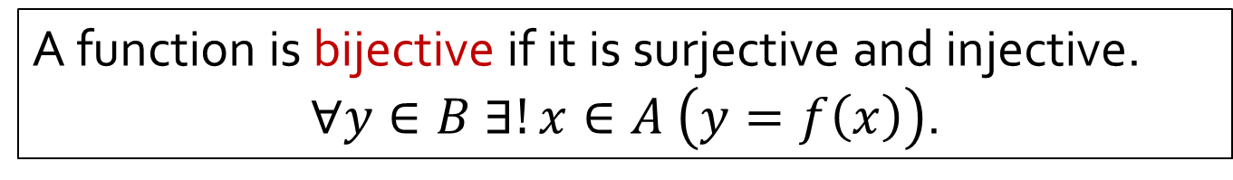
Recap: Definition 9.3.6
A function $f:A→B$ is surjective if
$∀y∈B ∃x∈A \left(y=f\left(x\right)\right)$.
A function $f:A→B$ is injective if
$∀x_{1},x_{2}∈A \left(f\left(x_{1}\right)=f\left(x_{2}\right)⇒x_{1}=x_{2}\right)$.
A function is bijective if it is surjective and injective.
$∀y∈B ∃!x∈A \left(y=f\left(x\right)\right)$.
(Surjective) Informally, every element in the codomain must have at least one arrow going into it.
(Injective) Informally, every element in the codomain must have at most one arrow going into it.
(Bijective) Informally, every element in the codomain must have exactly one arrow going into it.
$$∧$$
$$≡$$

Slide 7
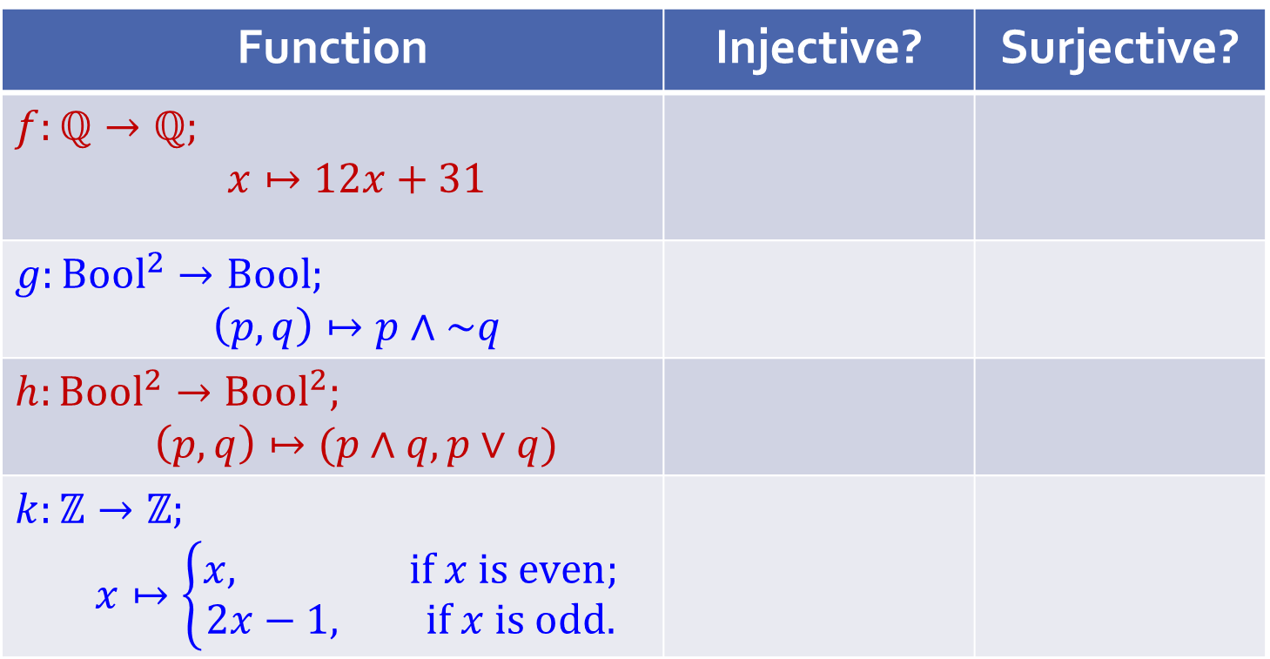
Q3.
Is the function injective? Surjective? Prove. If it is bijective, find the inverse function. Here denote by Bool the set {true; false}.
Quick check before we go into the details:
Function | Injective? | Surjective?
$$f:ℚ→ℚ;$$ $$x↦12x+31$$
$$g:Bool^{2}→Bool;$$ $$\left(p,q\right)↦p∧\sim q$$
$$h:Bool^{2}→Bool^{2};$$ $$\left(p,q\right)↦(p∧q,p∨q)$$
$$k:ℤ→ℤ;$$ $$x↦\left\{\begin{aligned}x, if x is even; \\ 2x−1, if x is odd.\end{aligned}\right.$$

Slide 8
Q3.
What does the previous table show?
A function can be
injective but not surjective;
surjective but not injective;
injective and surjective (i.e. bijective); or
neither injective nor surjective.
All four cases are possible!
Try discussion question D2.

Slide 9
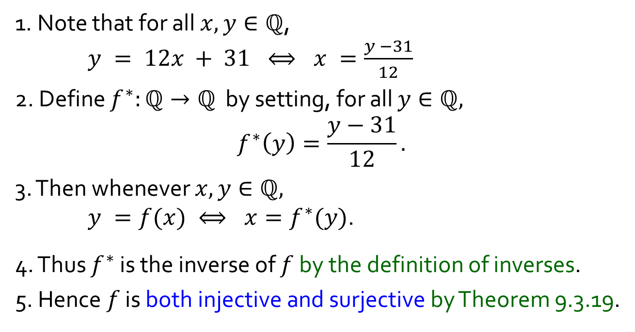
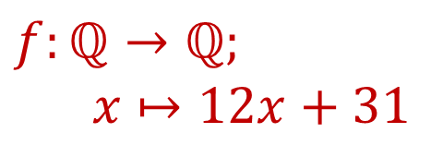
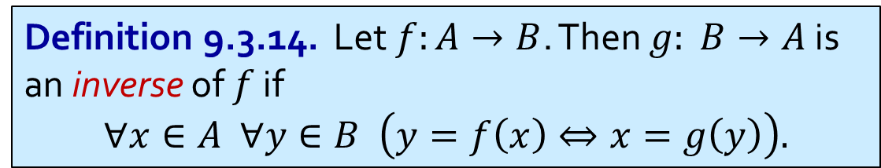
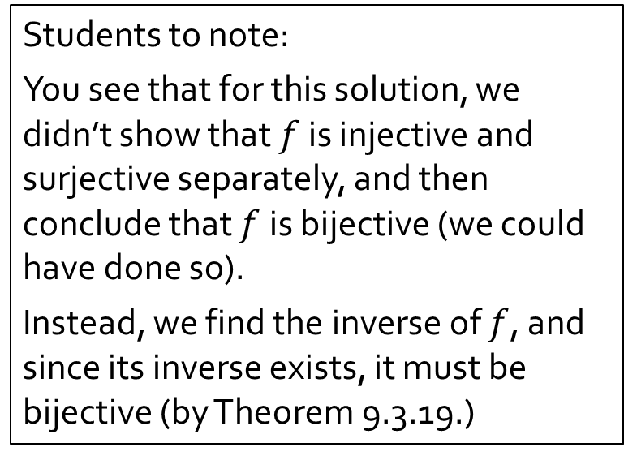
Q3.
$$f:ℚ→ℚ;$$
$$x↦12x+31$$
Both Injective and Surjective
Part 1
Students to note:
You see that for this solution, we didn’t show that $f$ is injective and surjective separately, and then conclude that $f$ is bijective (we could have done so).
Instead, we find the inverse of $f$, and since its inverse exists, it must be bijective (by Theorem 9.3.19.)
1. Note that for all $x,y∈ℚ$,
$y = 12x + 31 ⟺ x =\frac{y −31}{12}$
2. Define $f^{∗}:ℚ→ℚ$ by setting, for all $y∈ℚ,$ $$f^{∗}\left(y\right)=\frac{y−31}{12}.$$
3. Then whenever $x,y∈ℚ,$
$y =f(x) ⟺ x=f^{∗}(y)$.
4. Thus $f^{∗}$ is the inverse of $f$ by the definition of inverses.
5. Hence $f$ is both injective and surjective by Theorem 9.3.19.
Definition 9.3.14. Let $f:A→B$. Then $g: B→A$ is an inverse of $f$ if
$$∀x∈A ∀y∈B \left(y=f\left(x\right)⇔x=g\left(y\right)\right).$$
Theorem 9.3.19. A function is bijective iff it has an inverse.

Slide 10
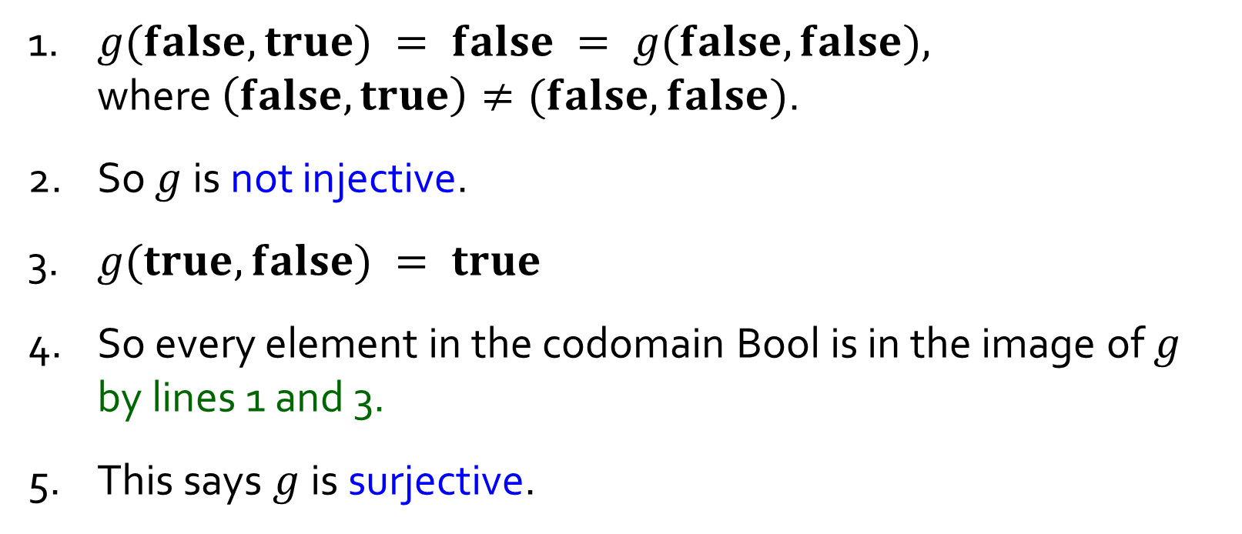
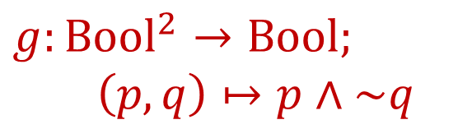
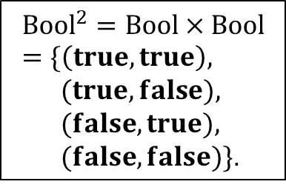
Q3.
$$g:Bool^{2}→Bool;$$
$$\left(p,q\right)↦p∧\sim q$$
Not Injective But Surjective
Part 2
$${Bool}^{2}=Bool×Bool=\{\left(true,true\right),$$
$(true,false),$
$(false,true),$
$(false,false)\}$.
1. $g(false,true) = false = g(false,false),$
where $\left(false,true\right)≠(false,false)$.
2. So $g$ is not injective.
3. $g(true, false) = true$
4. So every element in the codomain Bool is in the image of $g$ by lines 1 and 3.
5. This says $g$is surjective.

Slide 11
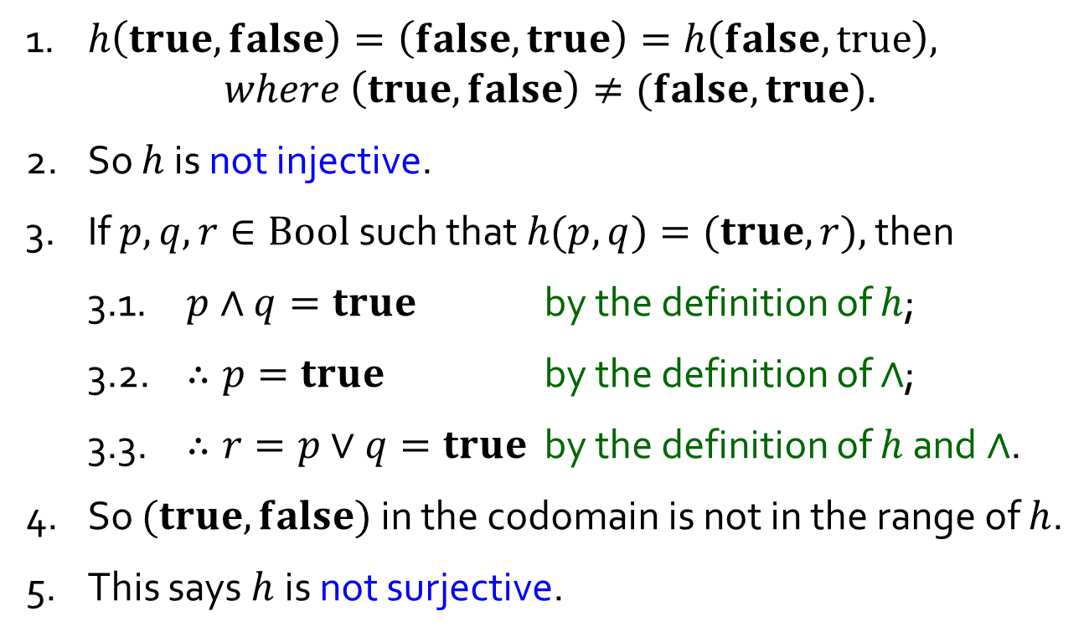
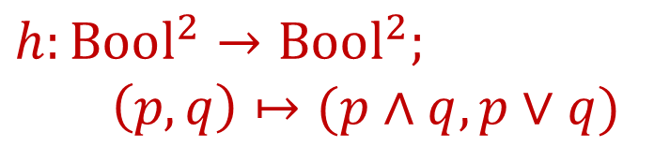
Q3.
$$h:Bool^{2}→Bool^{2};$$
$$\left(p,q\right)↦(p∧q,p∨q)$$
Not Injective, Not Surjective
Part 3
$${Bool}^{2}=Bool×Bool=\{\left(true,true\right),$$
$(true,false),$
$(false,true),$
$(false,false)\}$.
1. $h\left(true,false\right)=\left(false,true\right)=h\left(false, true\right),$
$$where \left(true, false\right)≠(false, true).$$
2. So $h$ is not injective.
3. If $p,q,r∈Bool$such that $h(p,q)=(true,r),$ then
3.1. $p∧q=true$ by the definition of $h$;
3.2. $∴p=true$ by the definition of $∧$;
3.3. $∴r=p∨q=true$ by the definition of $h$ and $∧$.
4. So $(true,false)$ in the codomain is not in the range of $h$.
5. This says $h$is not surjective.

Slide 12
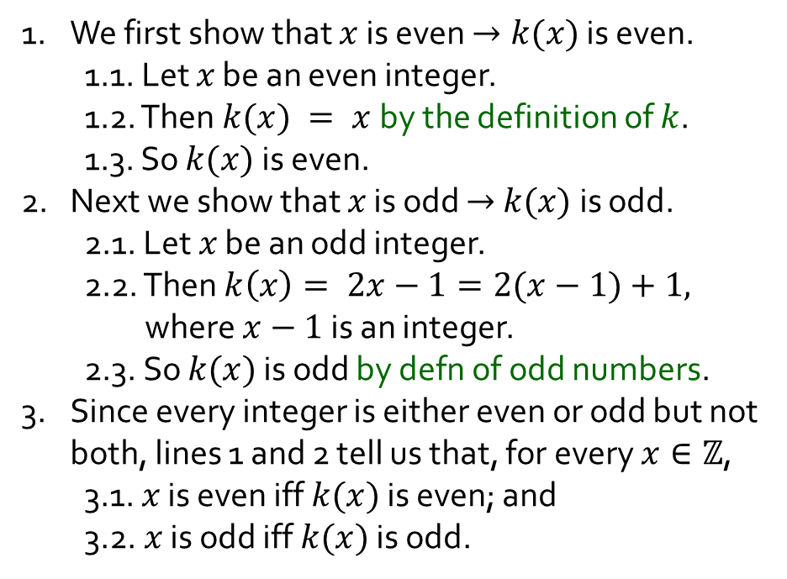
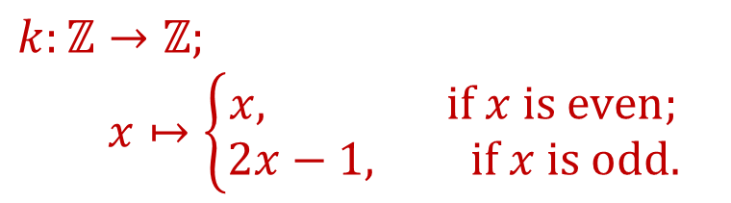
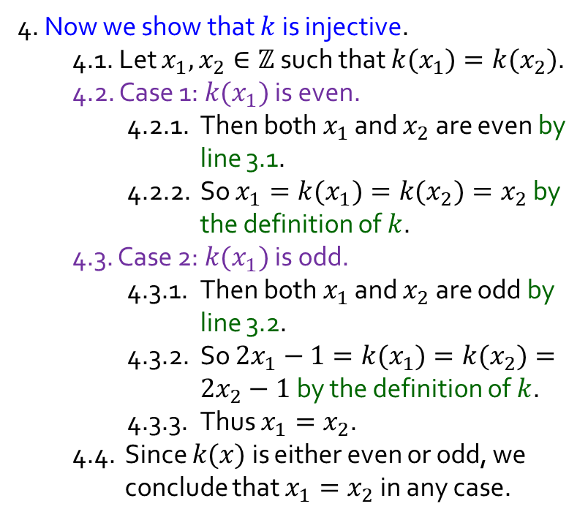
Q3.
Fact. Every integer is either odd or even, but not both.
$$k:ℤ→ℤ;$$
$$x↦\left\{\begin{aligned}x, if x is even; \\ 2x−1, if x is odd.\end{aligned}\right.$$
Injective, Not Surjective
Part 4
4. Now we show that $k$ is injective.
4.1. Let $x_{1},x_{2}∈ℤ$such that $k(x_{1})=k(x_{2})$.
4.2. Case 1: $k(x_{1})$ is even.
4.2.1. Then both $x_{1}$ and $x_{2}$are even by line 3.1.
4.2.2. So $x_{1}=k(x_{1})=k(x_{2})=x_{2}$ by the definition of $k$.
4.3. Case 2: $k(x_{1})$ is odd.
4.3.1. Then both $x_{1}$ and $x_{2}$are odd by line 3.2.
4.3.2. So $2x_{1}−1=k(x_{1})=k(x_{2})=2x_{2}−1$ by the definition of $k$.
4.3.3. Thus $x_{1}=x_{2}$.
4.4. Since $k(x)$ is either even or odd, we conclude that $x_{1}=x_{2}$ in any case.
1. We first show that $x$ is even $→k(x)$ is even.
1.1. Let $x$ be an even integer.
1.2. Then $k(x) = x$by the definition of $k$.
1.3. So $k(x)$ is even.
2. Next we show that $x$ is odd $→$ $k(x)$is odd.
2.1. Let $x$ be an odd integer.
2.2. Then $k\left(x\right)= 2x−1=2(x−1)+1,$ where $x−1$is an integer.
2.3. So $k(x)$ is odd by defn of odd numbers.
3. Since every integer is either even or odd but not both, lines 1 and 2 tell us that, for every $x∈ℤ$,
3.1. $x$ is even iff $k(x)$ is even; and
3.2. $x$ is odd iff $k(x)$ is odd.
Continued …

Slide 13


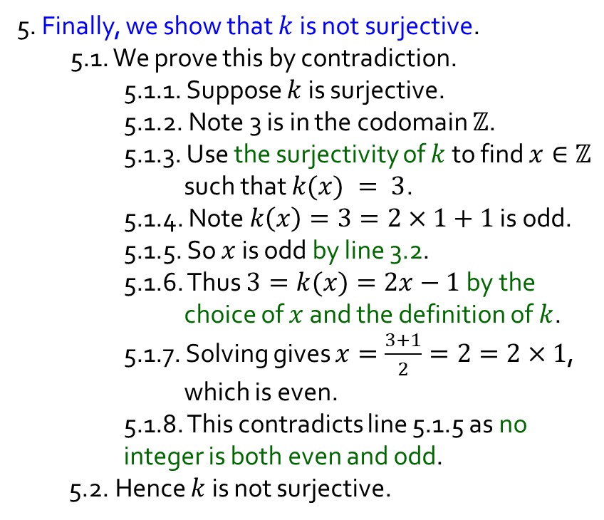
Q3.
Fact. Every integer is either odd or even, but not both.
$$k:ℤ→ℤ;$$
$$x↦\left\{\begin{aligned}x, if x is even; \\ 2x−1, if x is odd.\end{aligned}\right.$$
Injective, Not Surjective
Part 4
5. Finally, we show that $k$ is not surjective.
5.1. We prove this by contradiction.
5.1.1. Suppose $k$ is surjective.
5.1.2. Note 3 is in the codomain $ℤ$.
5.1.3. Use the surjectivity of $k$ to find $x∈ℤ$ such that $k(x) = 3$.
5.1.4. Note $k\left(x\right)=3=2×1+1$ is odd.
5.1.5. So $x$ is odd by line 3.2.
5.1.6. Thus $3=k(x)=2x−1$ by the choice of $x$ and the definition of $k$.
5.1.7. Solving gives $x=\frac{3+1}{2}=2=2×1$, which is even.
5.1.8. This contradicts line 5.1.5 as no integer is both even and odd.
5.2. Hence $k$ is not surjective.
4. Now we show that $k$ is injective.
4.1. Let $x_{1},x_{2}∈ℤ$such that $k(x_{1})=k(x_{2})$.
4.2. Case 1: $k(x_{1})$ is even.
4.2.1. Then both $x_{1}$ and $x_{2}$are even by line 3.1.
4.2.2. So$x_{1}=k(x_{1})=k(x_{2})=x_{2}$ by the definition of $k$.
4.3. Case 2: $k(x_{1})$ is odd.
4.3.1. Then both $x_{1}$ and $x_{2}$are odd by line 3.2.
4.3.2. So $2x_{1}−1=k(x_{1})=k(x_{2})=2x_{2}−1$ by the definition of $k$.
4.3.3. Thus $x_{1}=x_{2}$.
4.4. Since $k(x)$ is either even or odd, we conclude that $x_{1}=x_{2}$ in any case.

Slide 14

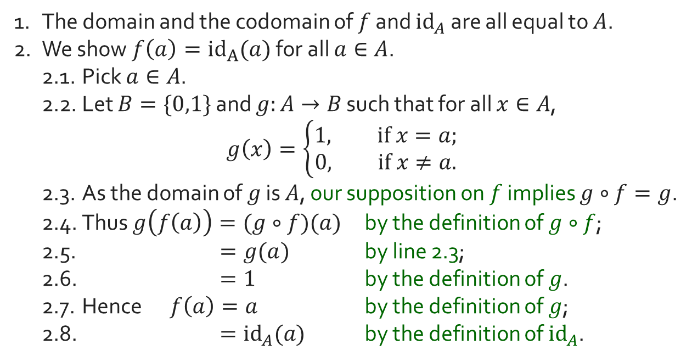

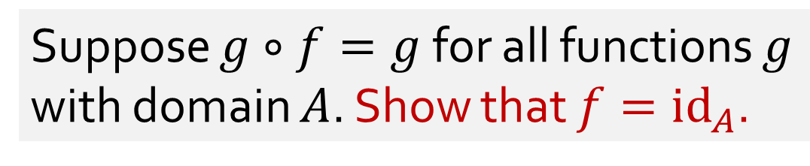
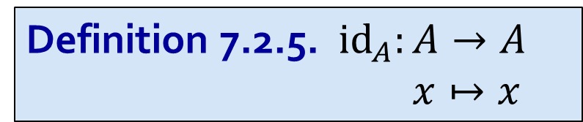




Q4.
Definition 7.2.5. $id_{A}:A→A$
$x↦x$
Let $A$ be a set and $f:A→A$.
Suppose $g∘f=g$ for all functions $g$ with domain $A$. Show that $f={id}_{A}$.
$$A$$
$$A$$
$$B$$
$$f$$
$$g$$
1. The domain and the codomain of $f$ and ${id}_{A}$ are all equal to $A$.
2. We show $f\left(a\right)={id}_{A}(a)$ for all $a∈A$.
2.1. Pick $a∈A$.
2.2. Let $B=\{0,1\}$ and $g:A→B$ such that for all $x∈A$,
$$g\left(x\right)=\left\{\begin{aligned}1, if x=a; \\ &0, if x≠a.\end{aligned}\right.$$
2.3. As the domain of $g$ is $A$, our supposition on $f$ implies $g∘f=g$.
2.4. Thus $g\left(f\left(a\right)\right)=(g∘f)(a)$ by the definition of $g∘f$;
2.5. $=g(a)$ by line 2.3;
2.6. $=1$ by the definition of $g$.
2.7. Hence $f\left(a\right)=a$ by the definition of $g$;
2.8. $={id}_{A}(a)$ by the definition of ${id}_{A}$.
$$g∘f=g$$

Slide 15
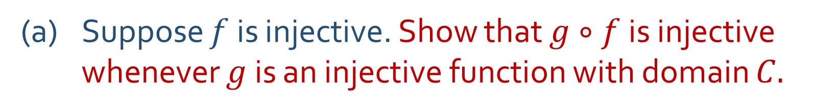

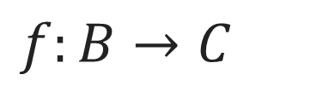

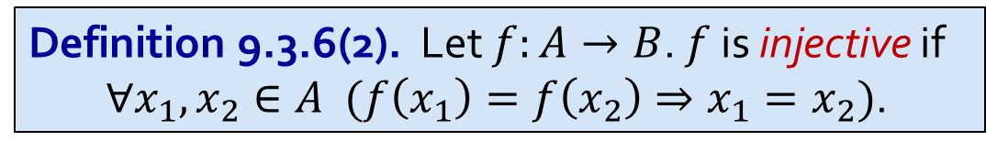


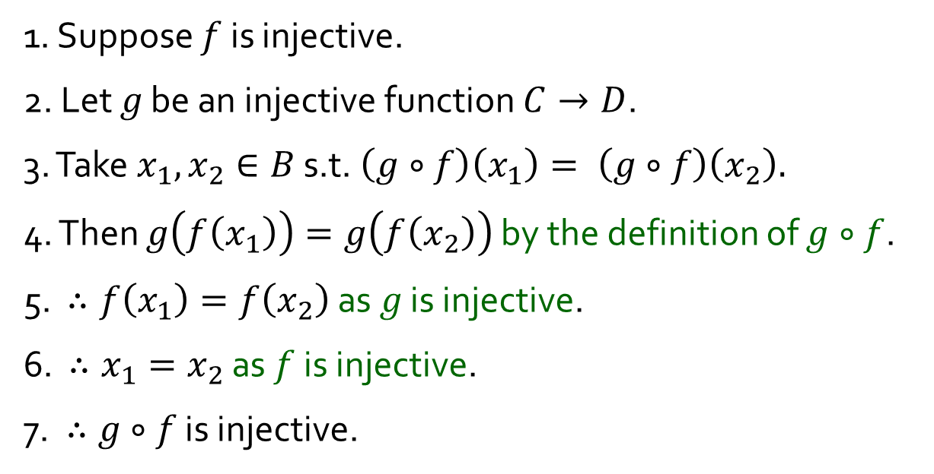
Q5.
Definition 9.3.6(2). Let $f:A→B$. $f$ is injective if
$∀x_{1},x_{2}∈A (f\left(x_{1}\right)=f\left(x_{2}\right)⇒x_{1}=x_{2})$.
$f:B→C$
(a) Suppose $f$ is injective. Show that $g∘f$is injective whenever $g$ is an injective function with domain $C.$
1. Suppose $f$ is injective.
2. Let 𝑔 be an injective function $C→D$.
3. Take $x_{1}, x_{2}∈B$ s.t. $\left(g∘f\right)\left(x_{1}\right)= \left(g∘f\right)\left(x_{2}\right).$
4. Then $g\left(f\left(x_{1}\right)\right)=g\left(f\left(x_{2}\right)\right)$ by the definition of $g∘f$.
5. $∴f\left(x_{1}\right)=f\left(x_{2}\right)$ as 𝑔 is injective.
6. $∴x_{1}=x_{2}$ as $f$ is injective.
7. $∴g∘f$ is injective.
$$B$$
$$C$$
$$D$$
$$f$$
$$g$$
$$g∘f$$

Slide 16
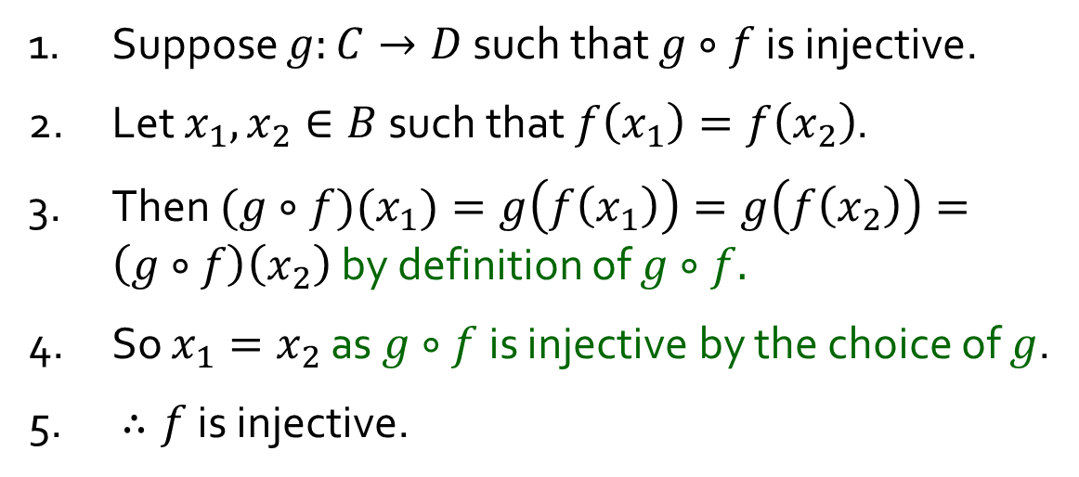

Q5.
Definition 9.3.6(2). Let $f:A→B$. $f$ is injective if
$∀x_{1},x_{2}∈A (f\left(x_{1}\right)=f\left(x_{2}\right)⇒x_{1}=x_{2})$.
$f:B→C$
(b) Suppose we have a function $g$ with domain $C$ such that $g∘f$ is injective. Show that $f$is injective$.$
1. Suppose $g:C→D$ such that $g∘f$ is injective.
2. Let $x_{1},x_{2}∈B$such that $f\left(x_{1}\right)=f\left(x_{2}\right)$.
3. Then $(g∘f)(x_{1})=g\left(f\left(x_{1}\right)\right)=g\left(f\left(x_{2}\right)\right)=\left(g∘f\right)\left(x_{2}\right)$ by definition of $g∘f.$
4. So $x_{1}=x_{2}$ as $g∘f$ is injective by the choice of $g$.
5. $∴f$ is injective.
$$B$$
$$C$$
$$D$$
$$f$$
$$g$$
$$g∘f$$

Slide 17

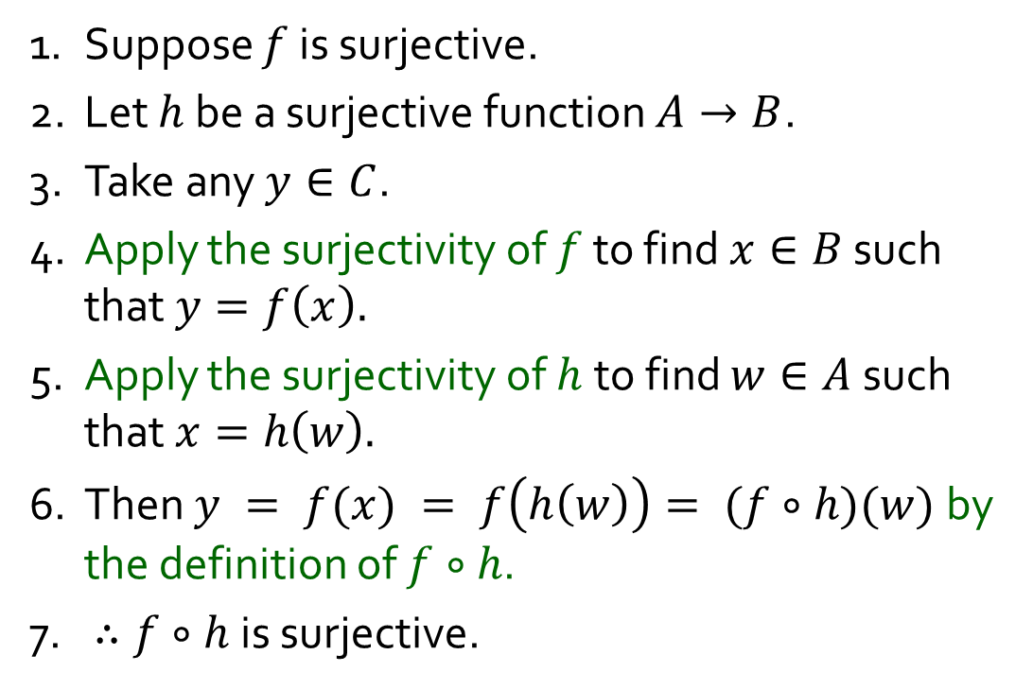

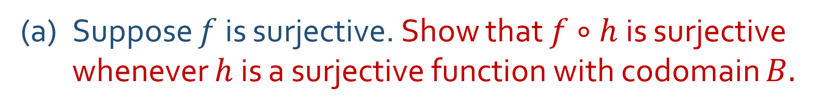

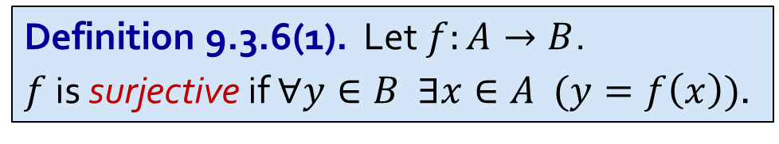



Q6.
Definition 9.3.6(1). Let $f:A→B$.
$f$ is surjective if $∀y∈B ∃x∈A (y=f\left(x\right))$.
$f:B→C$
(a) Suppose $f$ is surjective. Show that $f∘h$is surjective whenever $h$ is a surjective function with codomain $B.$
1. Suppose $f$ is surjective.
2. Let $h$ be a surjective function $A→B$.
3. Take any $y∈C$.
4. Apply the surjectivity of $f$ to find $x∈B$ such that $y=f\left(x\right).$
5. Apply the surjectivity of $h$to find $w∈A$ such that $x=h\left(w\right).$
6. Then $y = f(x) = f\left(h\left(w\right)\right)= (f∘h)(w)$by the definition of $f∘h$.
7. $∴f∘h$ is surjective.
$$A$$
$$B$$
$$C$$
$$h$$
$$f$$
$$f∘h$$

Slide 18
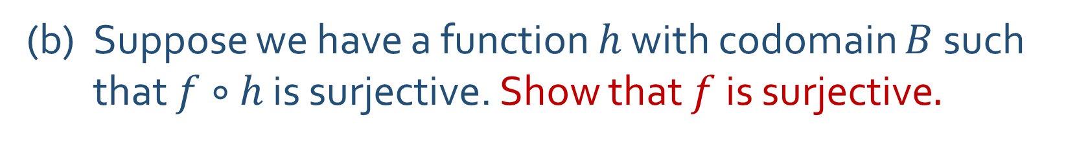
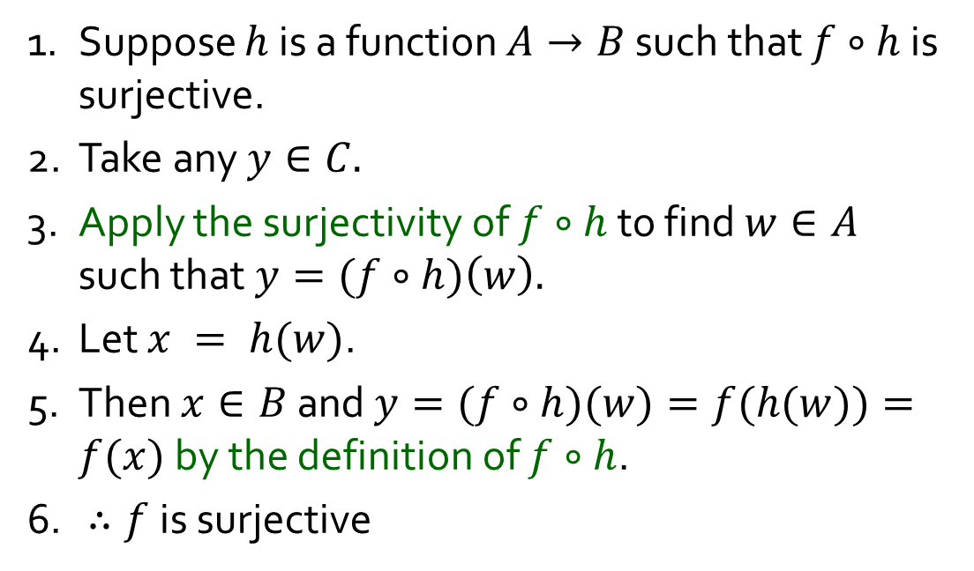
Q6.
Definition 9.3.6(1). Let $f:A→B$.
$f$ is surjective if $∀y∈B ∃x∈A (y=f\left(x\right))$.
$f:B→C$
(b) Suppose we have a function $h$ with codomain $B$ such that $f∘h$ is surjective. Show that $f$is surjective$.$
1. Suppose $h$ is a function $A→B$ such that $f∘h$ is surjective.
2. Take any $y∈C.$
3. Apply the surjectivity of $f∘h$ to find $w∈A$ such that $y=(f∘h)\left(w\right).$
4. Let $x = h(w)$.
5. Then $x∈B$and $y=(f∘h)(w)=f(h(w))=f(x)$ by the definition of $f∘h$.
6. $∴f$ is surjective
$$A$$
$$B$$
$$C$$
$$h$$
$$f$$
$$f∘h$$

Slide 19
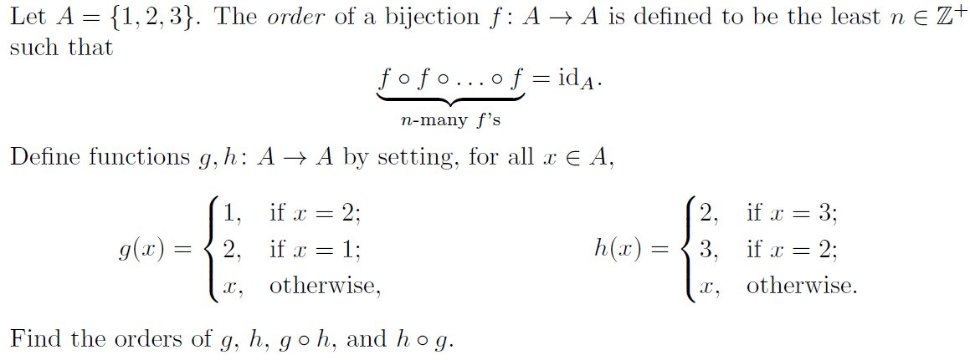


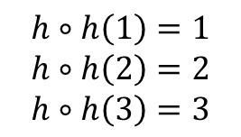







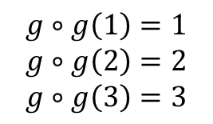



Q7.
$$A$$
$$g$$
$$A$$
$$g$$
$$A$$
$$A$$
$$h$$
$$A$$
$$h$$
$$A$$
1
2
3
1
2
3
1
2
3
$$g∘g\left(1\right)=1$$
$$g∘g\left(2\right)=2$$
$$g∘g\left(3\right)=3$$
1
2
3
1
2
3
1
2
3
$$h∘h\left(1\right)=1$$
$$h∘h\left(2\right)=2$$
$$h∘h\left(3\right)=3$$
$∴$ order of $g$ = 2
$∴$ order of $h$ = 2

Slide 20
















Q7.
Is $\left(g∘h\right)∘\left(g∘h\right)={id}_{A}$?
Is $\left(g∘h\right)∘\left(g∘h\right)∘\left(g∘h\right)={id}_{A}$?
$$A$$
$$h$$
$$A$$
$$g$$
$$A$$
$$A$$
$$A$$
$$A$$
$$A$$
1
2
3
1
2
3
1
2
3
1
2
3
1
2
3
1
2
3
1
2
3
$$≡$$
$$g∘h$$
$$g∘h$$
$$g∘h$$
$$g∘h$$

Slide 21










Q7.
Is $\left(h∘g\right)∘\left(h∘g\right)={id}_{A}$?
Is $\left(h∘g\right)∘\left(h∘g\right)∘\left(h∘g\right)={id}_{A}$?
$$A$$
$$g$$
$$A$$
$$h$$
$$A$$
$$A$$
$$A$$
$$A$$
$$A$$
1
2
3
1
2
3
1
2
3
1
2
3
1
2
3
1
2
3
1
2
3
$$≡$$
$$h∘g$$
$$h∘g$$
$$h∘g$$
$$h∘g$$

Slide 22

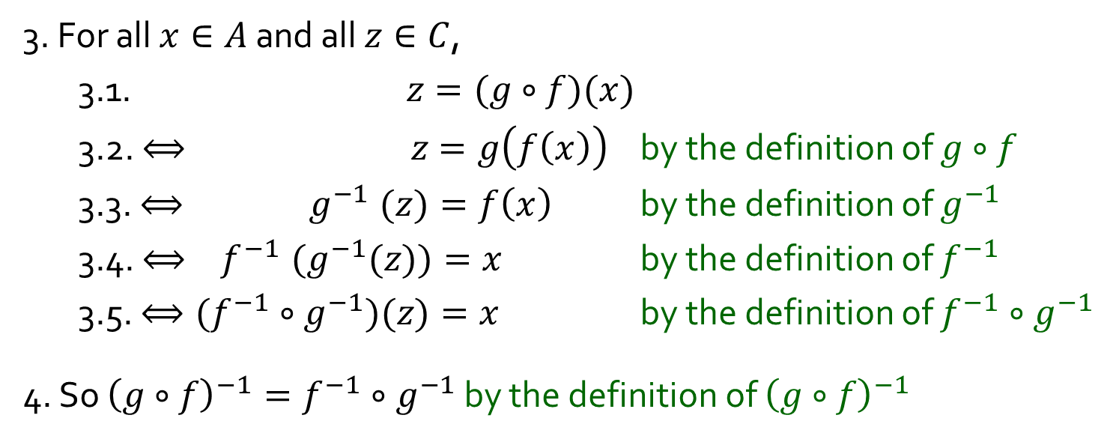

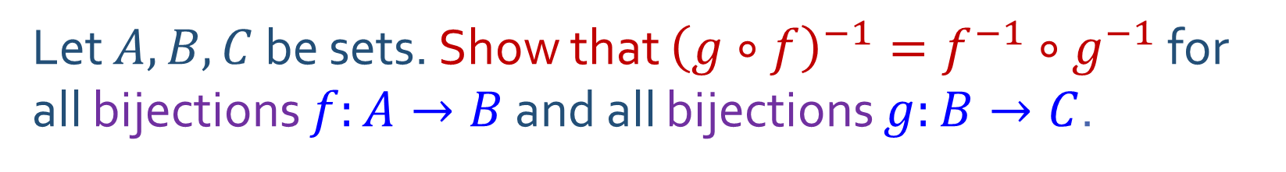



Q8.
Let $A, B, C$ be sets. Show that ${\left(g∘f\right)}^{−1}=f^{−1}∘g^{−1}$ for all bijections $f:A→B$ and all bijections $g:B→C$.
$$A$$
$$f$$
$$B$$
$$g$$
$$C$$
What might lines 1 and 2 be?
3. For all $x∈A$ and all $z∈C$,
3.1. $z=(g∘f)(x)$
3.2. $⟺ z=g\left(f\left(x\right)\right)$ by the definition of $g∘f$
3.3. ${⟺ g}^{−1}(z)=f\left(x\right)$ by the definition of $g^{−1}$
3.4. ${{⟺ f}^{−1}(g}^{−1}(z))=x$ by the definition of $f^{−1}$
3.5. $⟺({f^{−1}∘g}^{−1})(z)=x$ by the definition of $f^{−1}∘g^{−1}$
4. So ${\left(g∘f\right)}^{−1}=f^{−1}∘g^{−1}$ by the definition of ${\left(g∘f\right)}^{−1}$
:
:
:
:
:
:
$$g∘f$$
Definition 9.3.14. Let $f:A→B$. Then $g: B→A$ is an inverse of $f$ if
$$∀x∈A ∀y∈B \left(y=f\left(x\right)⇔x=g\left(y\right)\right).$$
Theorem 9.3.19. A function is bijective iff it has an inverse.

Slide 23

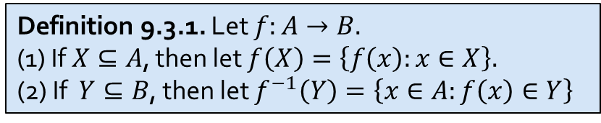
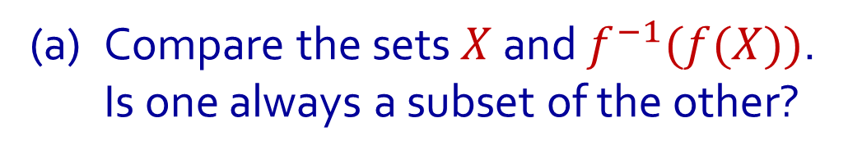
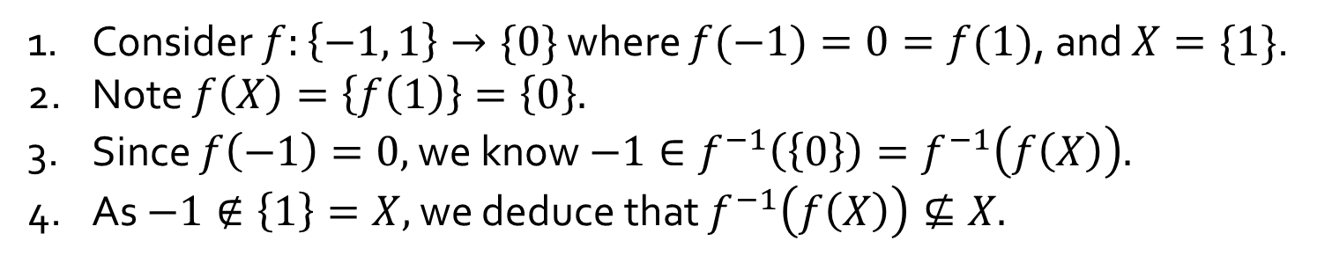




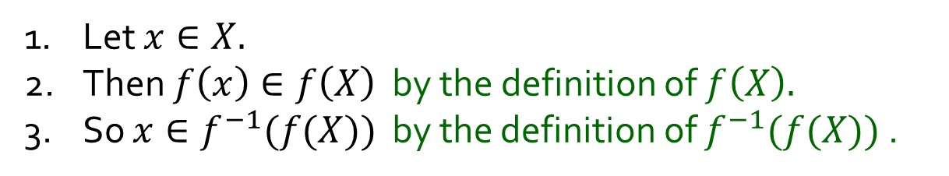



Q9.
Let $f:A→B$ be a function. Let $X⊆A$ and $Y⊆B$.
(a) Compare the sets $X$ and $f^{−1}(f(X))$.
Is one always a subset of the other?
$$A$$
$$f$$
$$B$$
$$f^{−1}\left(f\left(X\right)\right)$$
Is $X⊆f^{−1}(f(X))$ always true?
Yes
$$f(X)$$
1. Let $x∈X.$
2. Then $f\left(x\right)∈f\left(X\right)$ by the definition of $f\left(X\right).$
3. So $x∈f^{−1}(f(X))$ by the definition of $f^{−1}(f(X))$ .
$$X$$
Is$f^{−1}(f(X))⊆X$ always true?
No
1. Consider $f:\left\{−1, 1\right\}→\{0\}$ where $f(−1)=0=f(1)$, and $X=\{1\}$.
2. Note $f\left(X\right)=\left\{f\left(1\right)\right\}=\left\{0\right\}.$
3. Since $f\left(−1\right)=0,$ we know $−1∈f^{−1}\left(\left\{0\right\}\right)=f^{−1}\left(f\left(X\right)\right).$
4. As $−1∉\left\{1\right\}=X,$ we deduce that $f^{−1}\left(f\left(X\right)\right)⊈X.$
Definition 9.3.1. Let $f:A→B.$
(1) If $X⊆A$, then let $f\left(X\right)=\left\{f\left(x\right):x∈X\right\}.$
(2) If $Y⊆B$, then let $f^{−1}\left(Y\right)=\left\{x∈A:f\left(x\right)∈Y\right\}$

Slide 24

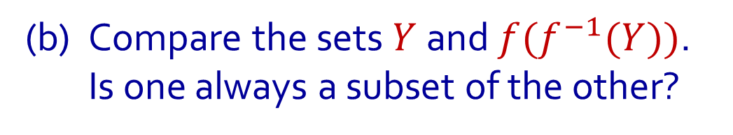
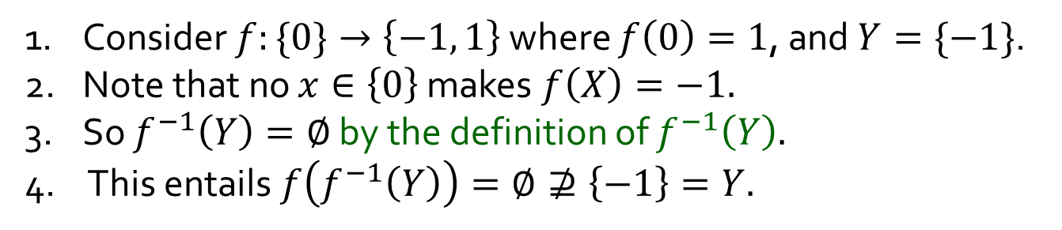






Q9.
Let $f:A→B$ be a function. Let $X⊆A$ and $Y⊆B$.
(b) Compare the sets $Y$ and $f(f^{−1}(Y))$.
Is one always a subset of the other?
$$A$$
$$f$$
$$B$$
Is $f(f^{−1}(Y))⊆Y$ always true?
Yes
$f^{−1}(Y$)
$$f\left(f^{−1}\left(Y\right)\right)$$
Take any $y∈f(f^{−1}\left(Y\right)).$
2. There is some $x∈f^{−1}\left(Y\right)$ s.t. $y=f\left(x\right)$ by the def^{n} of $f\left(f^{−1}\left(Y\right)\right)$.
3. As $x∈f^{−1}\left(Y\right),$ we get $y′∈Y$ which makes $y′=f(x)$.
4. Since $f$ is a function, $y=f\left(x\right)=y^{′}∈Y$.
$$Y$$
Is $Y⊆f(f^{−1}(Y))$ always true?
No
1. Consider $f:\{0\}→\left\{−1, 1\right\}$ where $f\left(0\right)=1$, and $Y=\{−1\}$.
2. Note that no $x∈\left\{0\right\}$ makes $f\left(X\right)=−1.$
3. So $f^{−1}\left(Y\right)=∅$ by the definition of $f^{−1}\left(Y\right).$
4. This entails $f\left(f^{−1}\left(Y\right)\right)=∅⊉\left\{−1\right\}=Y.$
Definition 9.3.1. Let $f:A→B.$
(1) If $X⊆A$, then let $f\left(X\right)=\left\{f\left(x\right):x∈X\right\}.$
(2) If $Y⊆B$, then let $f^{−1}\left(Y\right)=\left\{x∈A:f\left(x\right)∈Y\right\}$

Slide 25
END OF FILE

